Slide 1



Evaluating quantitative and qualitative impact indicators: pitfalls and challenges
Steven Hill, Director of Research
Methods & Instruments for Assessing the Societal Impact of Research
AESIS, King’s College, London
06 November 2019

Slide 2
Overview of session
Using case study evidence to measure impact
  Introduction to UK Research Excellence Framework (REF)
  Strengths and weaknesses of case studies
  Questions?
Quantitative indicator use in case studies
  What indicators are used?
  Consistency and coverage
  Questions?
Role of altmetrics in impact assessment
  Relationship between altmetrics and impact
  Altmetrics as early indicators
  Questions?
Implications for your the preparation of your case study response

Slide 3
Overview of session
Using case study evidence to measure impact
  Introduction to UK Research Excellence Framework (REF)
  Strengths and weaknesses of case studies
  Questions?
Quantitative indicator use in case studies
  What indicators are used?
  Consistency and coverage
  Questions?
Role of altmetrics in impact assessment
  Relationship between altmetrics and impact
  Altmetrics as early indicators
  Questions?
Implications for your the preparation of your case study response

Slide 4
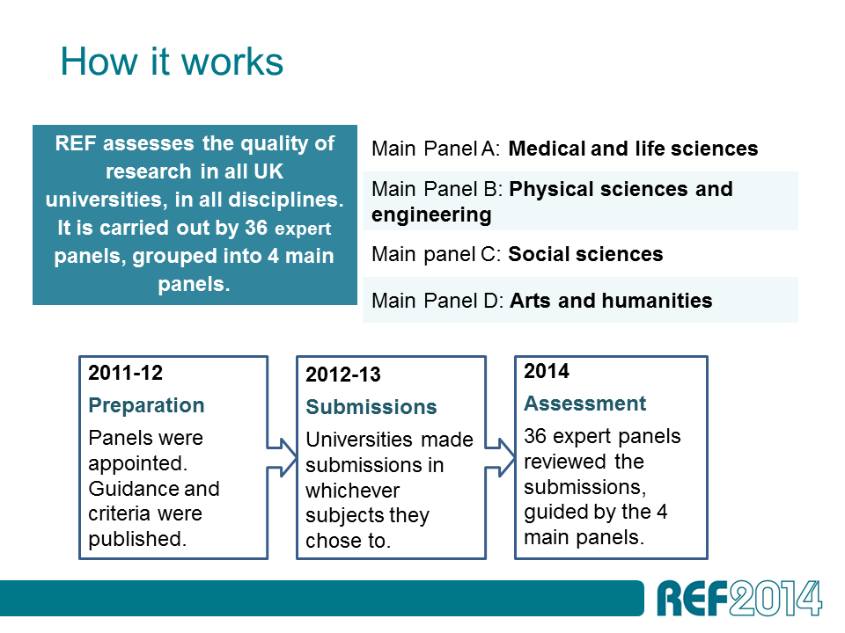
REF overview

Slide 5
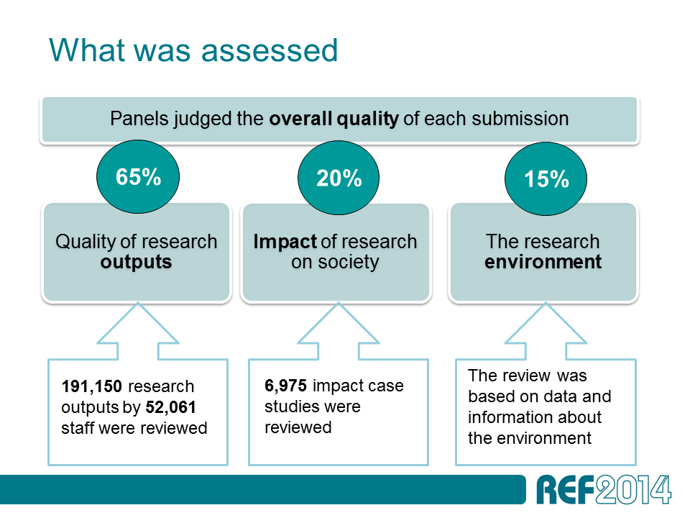
REF overview
Notes:
Replace this guidance text with your own bullet pointed content.
For further guidance please see https://www.bdadyslexia.org.uk/advice/employers/creating-a-dyslexia-friendly-workplace/dyslexia-friendly-style-guide

Slide 6
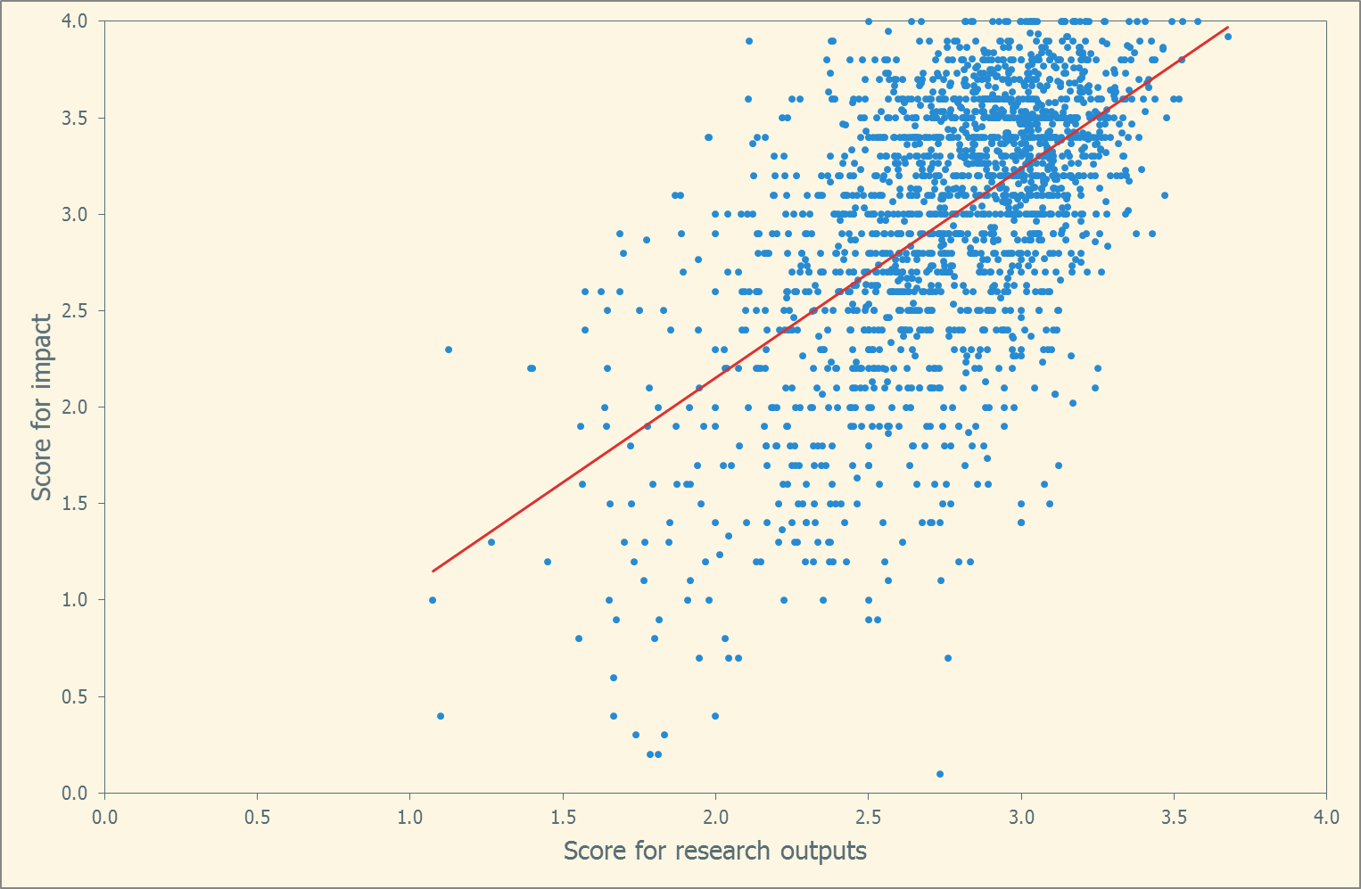
Impact and academic quality go hand-in-hand

Slide 7
REF overview
Notes:
Replace this guidance text with your own bullet pointed content.
For further guidance please see https://www.bdadyslexia.org.uk/advice/employers/creating-a-dyslexia-friendly-workplace/dyslexia-friendly-style-guide

Slide 8
REF overview
“an effect on, change or benefit to the economy, society, culture, public policy or services, health, the environment or quality of life, beyond academia”
4-page narrative
‘underpinning research’
evidence and corroboration
assessment by academics and research users
Notes:
Replace this guidance text with your own bullet pointed content.
For further guidance please see https://www.bdadyslexia.org.uk/advice/employers/creating-a-dyslexia-friendly-workplace/dyslexia-friendly-style-guide

Slide 9
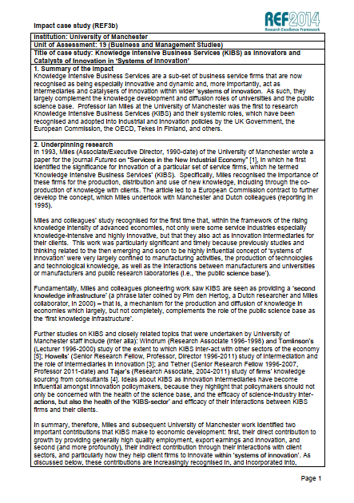
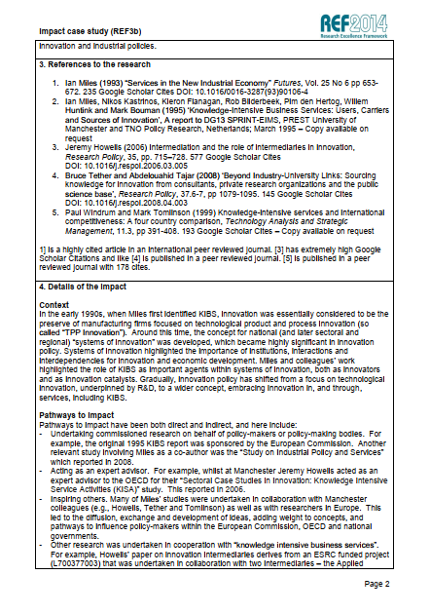
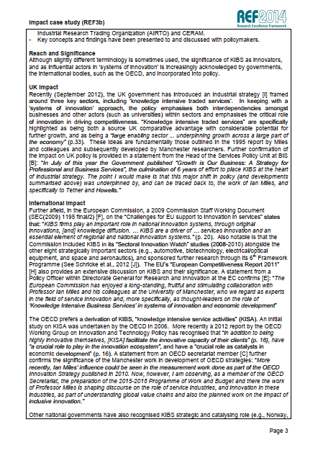
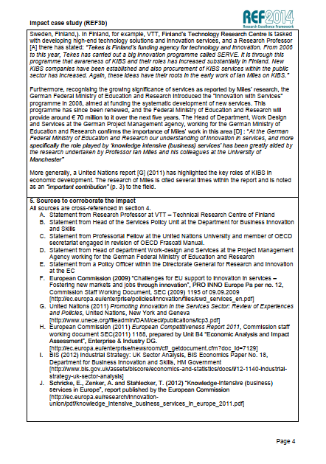

Slide 10
Strengths and weaknesses of case studies
Strengths
  Applicable to all disciplines/all type of impact
  Basis for robust quality evaluation
  Rich source of insight about impact processes

Slide 11
Source: King’s College London/Digital Science (2015) The nature, scale and beneficiaries of research impact
https://www.kcl.ac.uk/policy-institute/assets/ref-impact.pdf

Slide 12
Strengths and weaknesses of case studies
Strengths
  Applicable to all disciplines/all type of impact
  Basis for robust quality evaluation
  Rich source of insight about impact processes
Weaknesses
  Difficult to combine
  Time-consuming to produce (and so expensive)
  Not necessarily representative

Slide 13
Questions and discussion – part 1

Slide 14
Overview of session
Using case study evidence to measure impact
  Introduction to UK Research Excellence Framework (REF)
  Strengths and weaknesses of case studies
  Questions?
Quantitative indicator use in case studies
  What indicators are used?
  Consistency and coverage
  Questions?
Role of altmetrics in impact assessment
  Relationship between altmetrics and impact
  Altmetrics as early indicators
  Questions?
Implications for your the preparation of your case study response

Slide 15
Quantitative indicators in the REF impact case studies
The quantitative evidence supporting claims for impact was diverse and inconsistent, suggesting that the development of robust impact metrics is unlikely
There was a large amount of numerical data (ie, c170,000 items, or c70,000 with dates removed) that was inconsistent in its use and expression and could not be synthesized. […] Given this, and based on our analysis of the impact case studies, we would reiterate the conclusion […]: ‘impact indicators are not sufficiently developed and tested to be used to make funding decisions’ (Grant et al, 2010).
Source: King’s College London/Digital Science (2015) The nature, scale and beneficiaries of research impact
https://www.kcl.ac.uk/policy-institute/assets/ref-impact.pdf
Notes:
Replace this guidance text with your own bullet pointed content.
For further guidance please see https://www.bdadyslexia.org.uk/advice/employers/creating-a-dyslexia-friendly-workplace/dyslexia-friendly-style-guide

Slide 16
Example indicator: Quality-adjusted life years (QALY)
Measure of health impact; can be monetized
Used in 25 case studies
Estimate a total net gain of around £2 billion for these case studies
Challenges with using QALY:
    Inconsistent use (individual vs population)
    Varying monetization rate (£25k-£40k per QALY)
    Further information or evidence required

Slide 17
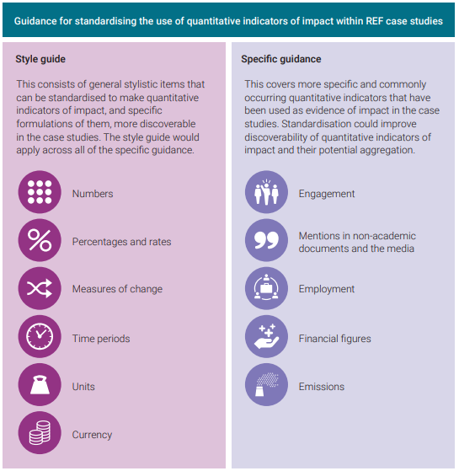

Standardising impact indicators
https://www.ref.ac.uk/media/1018/guidance-for-standardising-quantitative-indicators-of-impact.pdf

Slide 18
Questions and discussion – part 2

Slide 19
Overview of session
Using case study evidence to measure impact
  Introduction to UK Research Excellence Framework (REF)
  Strengths and weaknesses of case studies
  Questions?
Quantitative indicator use in case studies
  What indicators are used?
  Consistency and coverage
  Questions?
Role of altmetrics in impact assessment
  Relationship between altmetrics and impact
  Altmetrics as early indicators
  Questions?
Implications for your the preparation of your case study response

Slide 20
What are altmetrics?
Non-traditional metrics
  Not citations
  Downloads
  Social media shares
  Blog site mentions
  Policy document or clinical guidance citations
  News website mentions
  Wikipedia citations

Slide 21
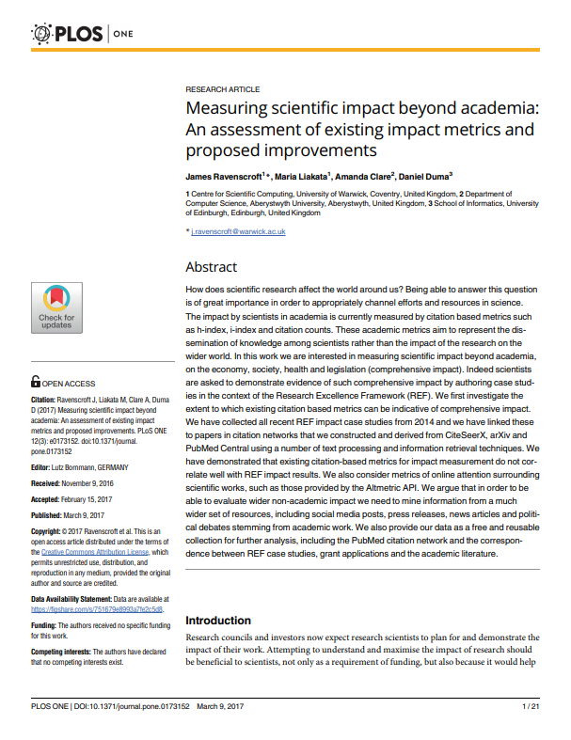
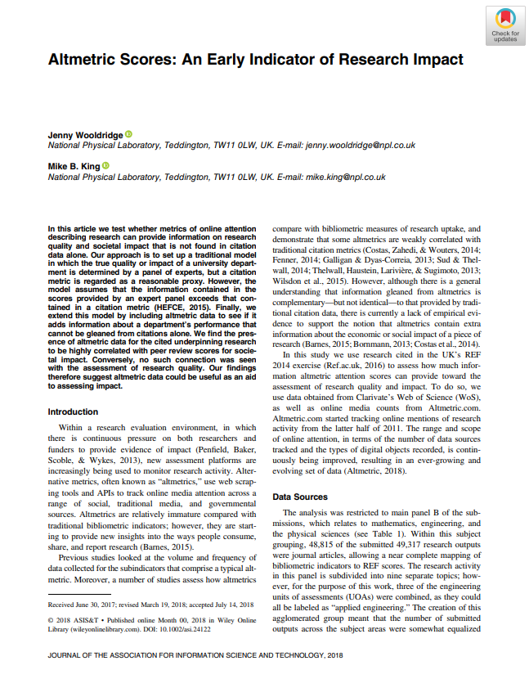
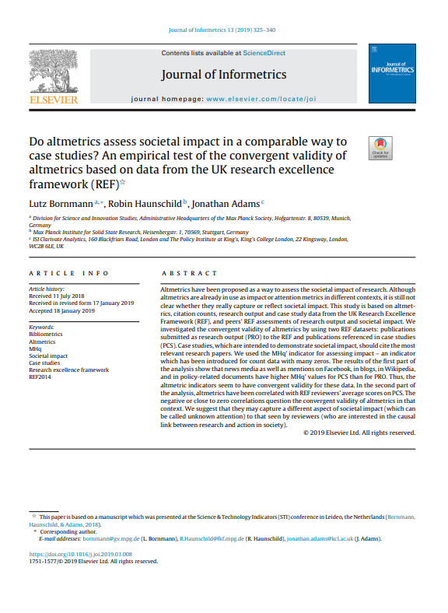
REF scores and altmetrics

Slide 22
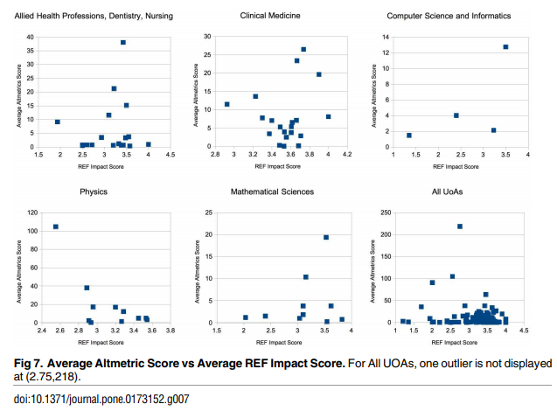
REF scores and altmetrics
Ravenscroft et al. (2017)
Citations and altmetrics compared to impact scores in 6 disciplines
Concluded no relationship between altmetrics and impact scores
https://doi.org/10.1371/journal.pone.0173152
Notes:
Replace this guidance text with your own bullet pointed content.
For further guidance please see https://www.bdadyslexia.org.uk/advice/employers/creating-a-dyslexia-friendly-workplace/dyslexia-friendly-style-guide

Slide 23
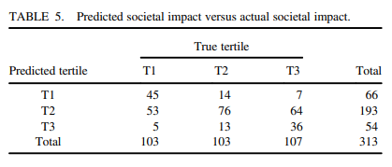
REF scores and altmetrics
Wooldridge and King (2018)
Altmetrics compared to impact scores in 9 disciplines (physical sciences and engineering)
Identified some ability to predict impact scores from altmetrics
https://doi.org/10.1002/asi.24122
Notes:
Replace this guidance text with your own bullet pointed content.
For further guidance please see https://www.bdadyslexia.org.uk/advice/employers/creating-a-dyslexia-friendly-workplace/dyslexia-friendly-style-guide

Slide 24
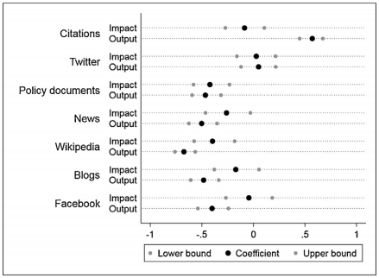
REF scores and altmetrics
Bornmann et al. (2019)
Studied two groups of articles – submitted as outputs or for impact
Compared correlations with impact and output scores
Concluded no relationship between altmetrics and impact scores
https://doi.org/10.1016/j.joi.2019.01.008
Notes:
Replace this guidance text with your own bullet pointed content.
For further guidance please see https://www.bdadyslexia.org.uk/advice/employers/creating-a-dyslexia-friendly-workplace/dyslexia-friendly-style-guide

Slide 25
Potential role for altmetrics
Juergen Wastl (Digital Science
find research that is worth pursuing around impact based on various sources (from mention to research)
find potential new leads (from research to mention)
https://www.altmetric.com/blog/altmetrics-and-the-ref-part-2-using-the-altmetric-explorer-for-preparations-for-your-ref-2021-submission/
Notes:
Replace this guidance text with your own bullet pointed content.
For further guidance please see https://www.bdadyslexia.org.uk/advice/employers/creating-a-dyslexia-friendly-workplace/dyslexia-friendly-style-guide

Slide 26
Questions and discussion – part 3

Slide 27
Overview of session
Using case study evidence to measure impact
  Introduction to UK Research Excellence Framework (REF)
  Strengths and weaknesses of case studies
  Questions?
Quantitative indicator use in case studies
  What indicators are used?
  Consistency and coverage
  Questions?
Role of altmetrics in impact assessment
  Relationship between altmetrics and impact
  Altmetrics as early indicators
  Questions?
Implications for your the preparation of your case study response

Slide 28






Steven Hill
Director of Research
0117 931 7334
steven.hill@re.ukri.org
@stevenhill, @ResEngland
www.ukri.org/re

